Slide 1

Affordable
Housing
Hawaiian Community Development Board
Notes:
Mahalo to the Senate & House Committees for examining and exploring ways to address the affordable housing needs of DHHL beneficiaries. I was asked to present HCDB efforts in this area.
HCDB is a nonprofit development company formed in 2000. It’s entire Board is made up of native Hawns with the majority being homesteaders. We are dedicated to helping and bettering Hawaiian communities using various approaches which includes developing affordable housing. We’ve done replacement home projects and tax credit projects.

Slide 2
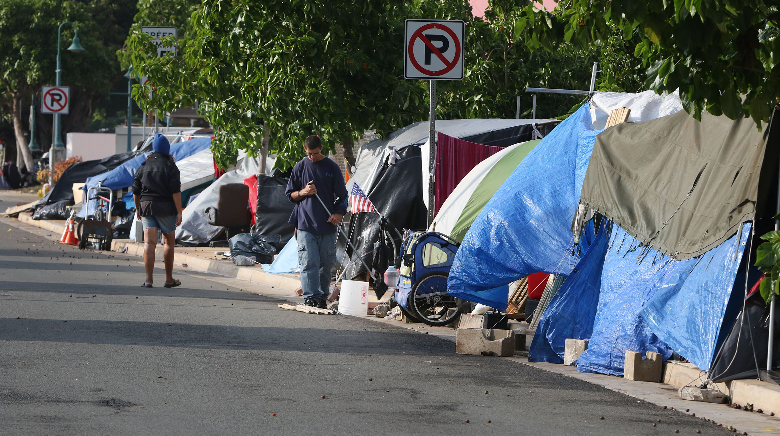
Emergency
Housing Crisis
Notes:
Hawaii is in housing crisis. With over 7,000 homeless, 5,000 on Oahu, and with a third being Hawaiian, with extremely overcrowded homestead households, with over 22,000 on DHHL’s waiting list, viable and effective solutions are needed. I like to present possible solutions.

Slide 3
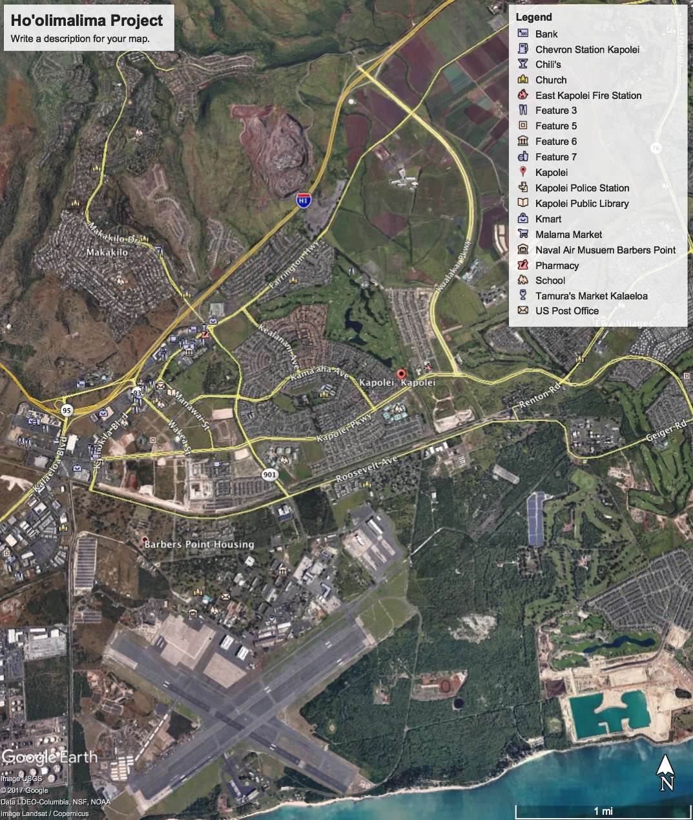
Ho’olimalima Project
Kapolei
Project Site
Notes:
About 15 years ago DHHL tried a new approach – Rent to Own – in the Maluohai Village.

Slide 4
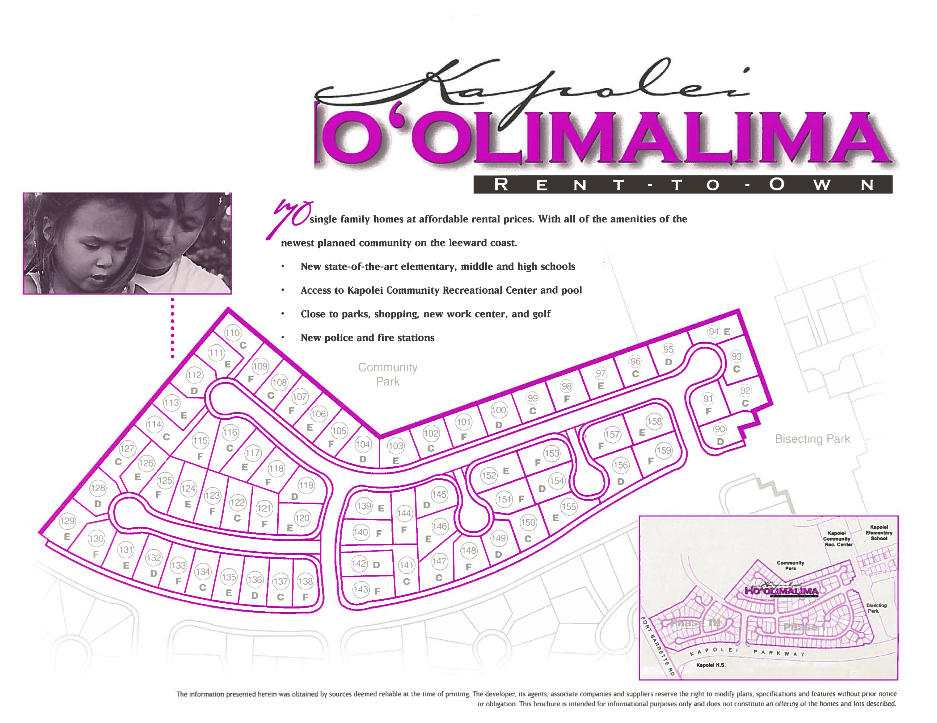
Notes:
DHHL retained Mark Development to build the project using a financing approach never used before.
MD received National recognition from the National Assn of Home Builders for the project. The approach generated $6.7 mil in equity which was passed onto homesteaders. Developed by Mark Development, Inc. – 69 of 70 families bought their houses– Homesteaders used NAHASDA to finance the purchase of the home they’d been living in for the last 15 years.
Purchase price: $63,000 to $77,000 for 3 & 4 bedroom houses

Slide 5
How do you finance a Project like this?
Notes:
Estimated Project Budget:
$11,920,000 Total Project Cost
$ 6,720,000 Equity from Sale of Tax Credits
$490,000 Grant from Fed Home Loan Bank of Seattle
$ 4,500,000 1st Mortgage from Bank of America

Slide 6
Major Financing Programs
Hawaii Housing Finance & Development Corporation
Low-income Housing Tax Credits (LIHTC)
Hula Mae Multi-Family Bonds (HMMF)
Rental Housing Revolving Fund (RHRF)
Notes:
9% LIHTC Project: 55%-60% LIHTC equity
20% conventional loan (FHB or BOH)
20%-25% equity gap (government programs)
Very Competitive – about $3.26 mil/yr = $32 mil – about 3 projects
4% LIHTC Project: (non-competitive)
40% LIHTC equity
20%-25% HMMF Bond
(Used with tax-exempt bonds – State has about $300 million bond cap)
35%-40% equity gap (government Programs)
(DHHL equity gap can be provided by DHHL’s NAHASDA funds).

Slide 7
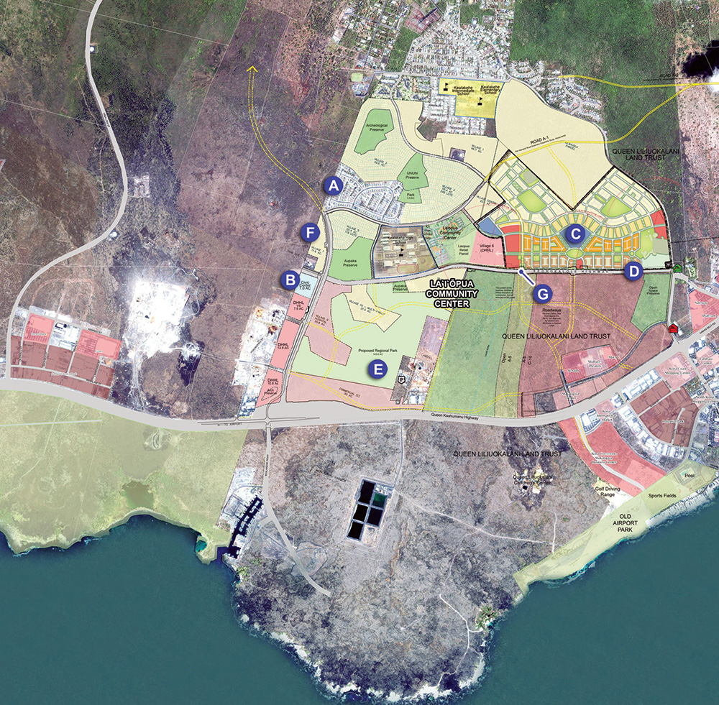
Villages of Lai Opua – Kona, Hawaii
Notes:
After 15 years DHHL is again trying to replicate the Hoolimalima project. Need to give credit to this administration for resurrecting an approach that works.

Slide 8
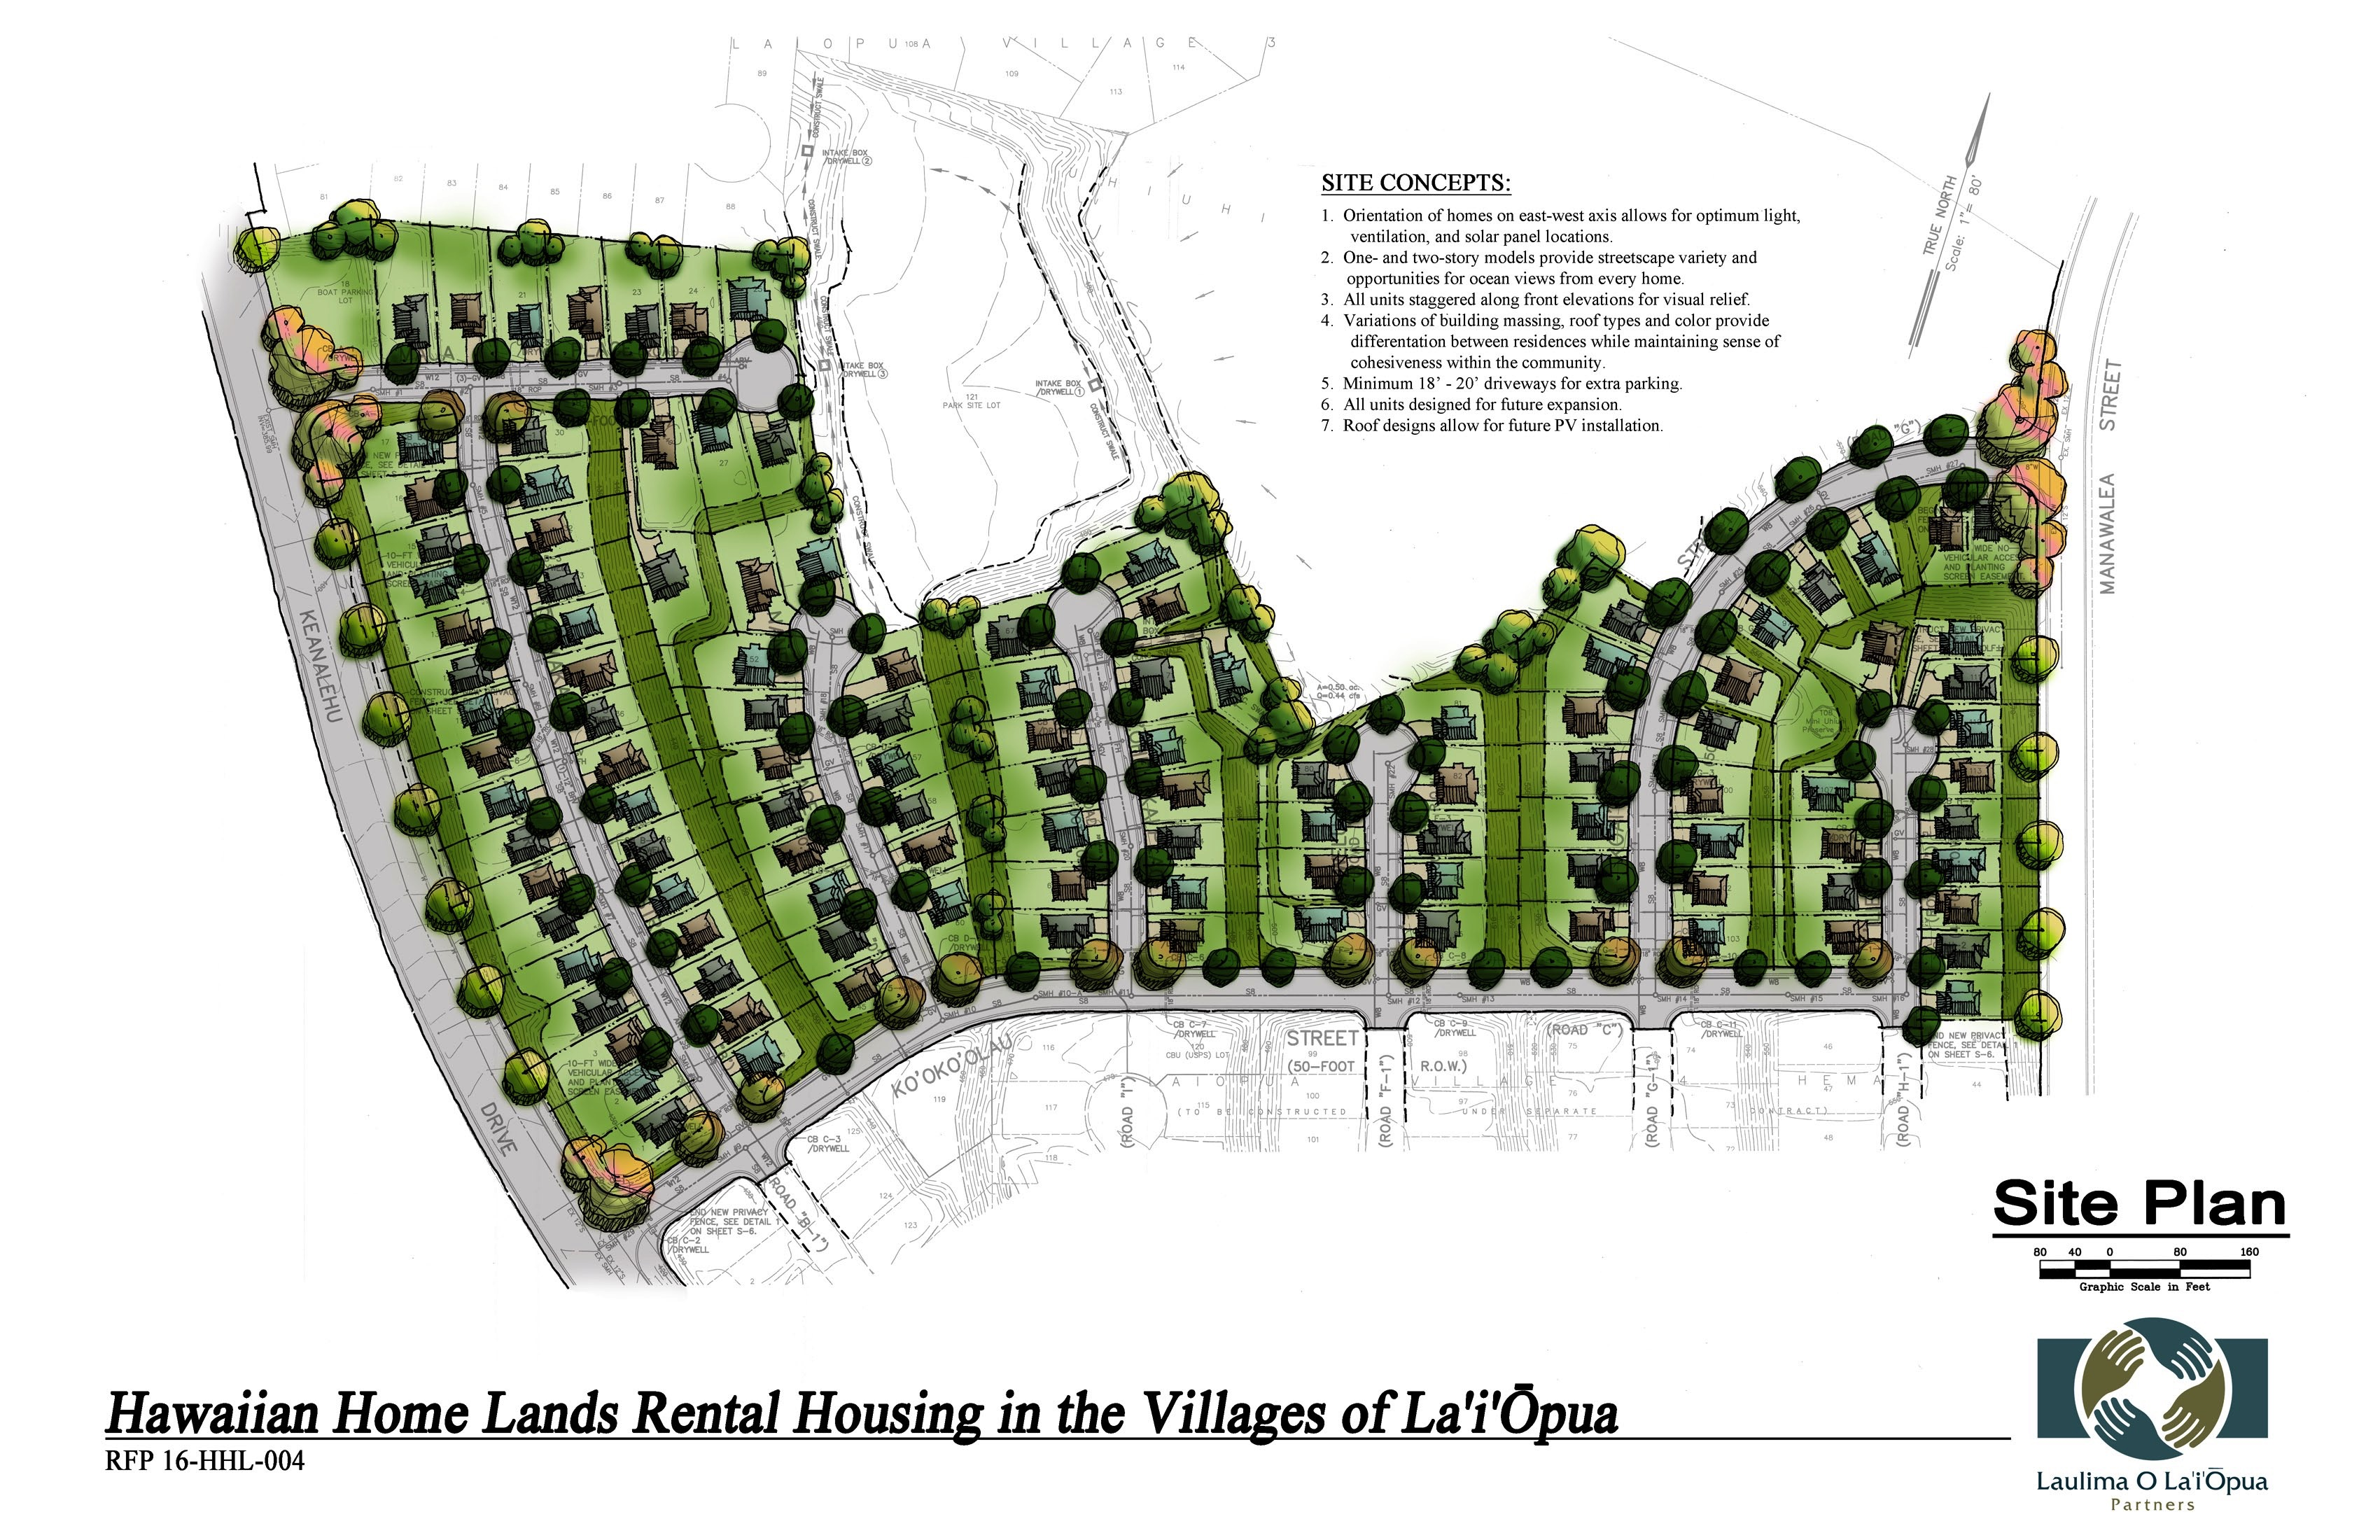
Laiopua Rent to Own Housing
Notes:
DHHL is about to award the project to 1 of 3 developers:
Laulima Dev LP:
163 houses
118 rent to own in Village 4, and 45 self-help homes in Village 5 working with Habitat for Humanity
Using 9% LIHTC, RHRF, & some NAHASDA money
Pricing $282,525 to $341,760 for 3 to 4 bedrms
SOURCES
PHASE I
PHASE II
TOTAL
9% LIHTC Equity (State & Federal)
21,808,171
21,808,171
43,616,342
Rental Housing Revolving Fund (RHRF)
5,902,798
5,902,798
11,805,595
NAHASDA-Rent to Own
235,000
235,000
470,000
NAHASDA-Self-Help 0% Interest Loans
3,375,000
2,700,000
6,075,000
DHHL Loan
4,900,000
4,900,000
9,800,000
Solar Tax Credit Equity
218,400
218,400
436,800
Deferred Developer Fee
235,029
235,029
470,058
TOTAL SOURCES
36,674,397
35,999,397
72,673,794

Slide 9
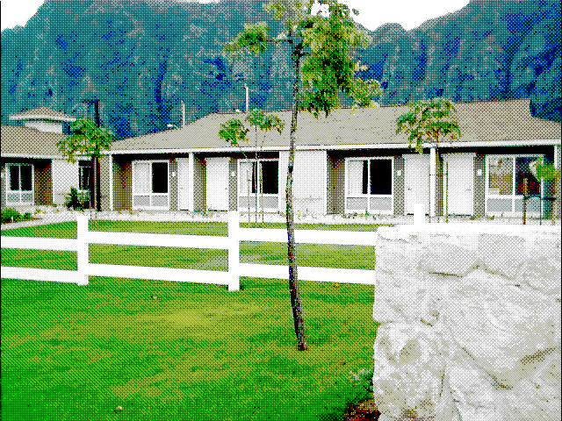
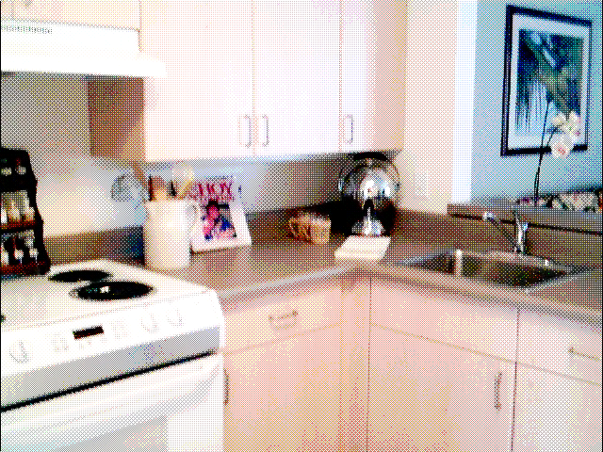
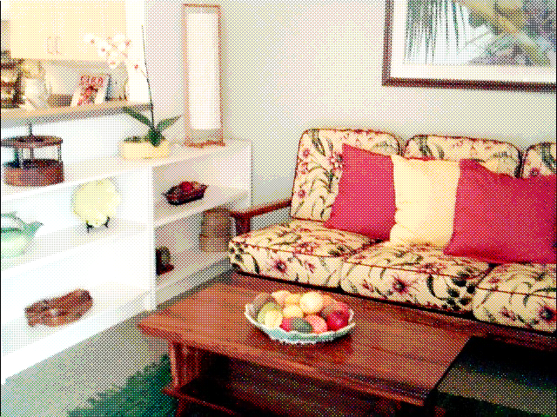
Waimanalo Kupuna Housing
Notes:
Result - $11.5 million project resulting in 85 garden one-bedrm rental apartments for low-income people 62 and older on DHHL land
Kulanakauhale Maluhia O Na Kupuna by Pacific Hsg Assistance Corp. – Marvin Awaya

Slide 10
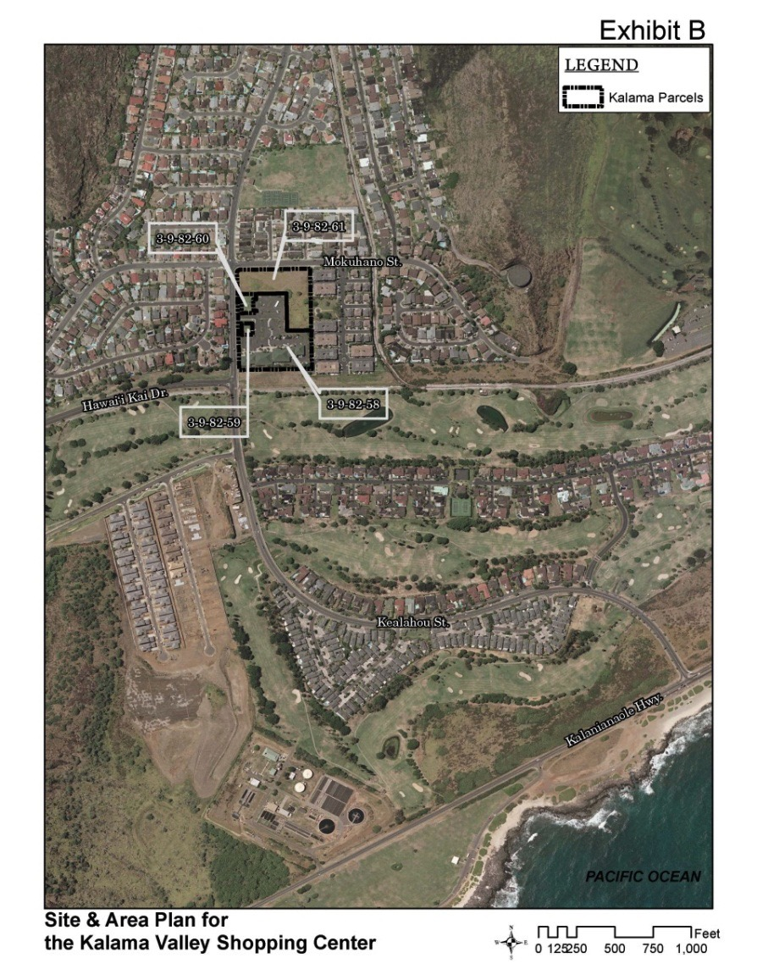
Kalama Valley Kupuna Housing Project
Notes:
Future Kupuna Village Center Project

Slide 11
Notes:
HCDB, In partnership with KS & Lunalilo Homes, is creating a pilot project. The alii trusts makes a lot of sense. Existing shopping Center is Kalama Valley owned by KS. Using LIHTC for the independent living kupuna. Private equity and financing will be used on the assisted living project. Hope to have a Weinberg Resource Center and possibly convert the under utilized commercial in ancillary services (drug store, beauty parlor, cafeteria)
28 Independent
90 Assisted
32 Memory Care
Project Cost: $42.5 mil

Slide 12
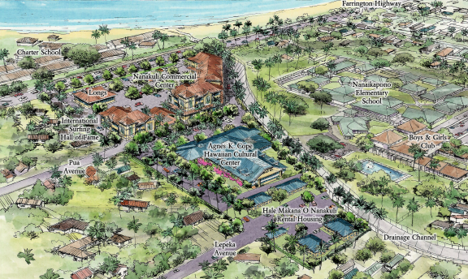
Nanakuli Village Center
Notes:
Signature Project
HCDB working with Nanakuli Homestead Assn and various partners to develop NVC.
2008 – 65 yr gen lease on 12 acres of DHHL lands.
Commercial/medical clinics
KS Agnes Cope Learning Center

Slide 13
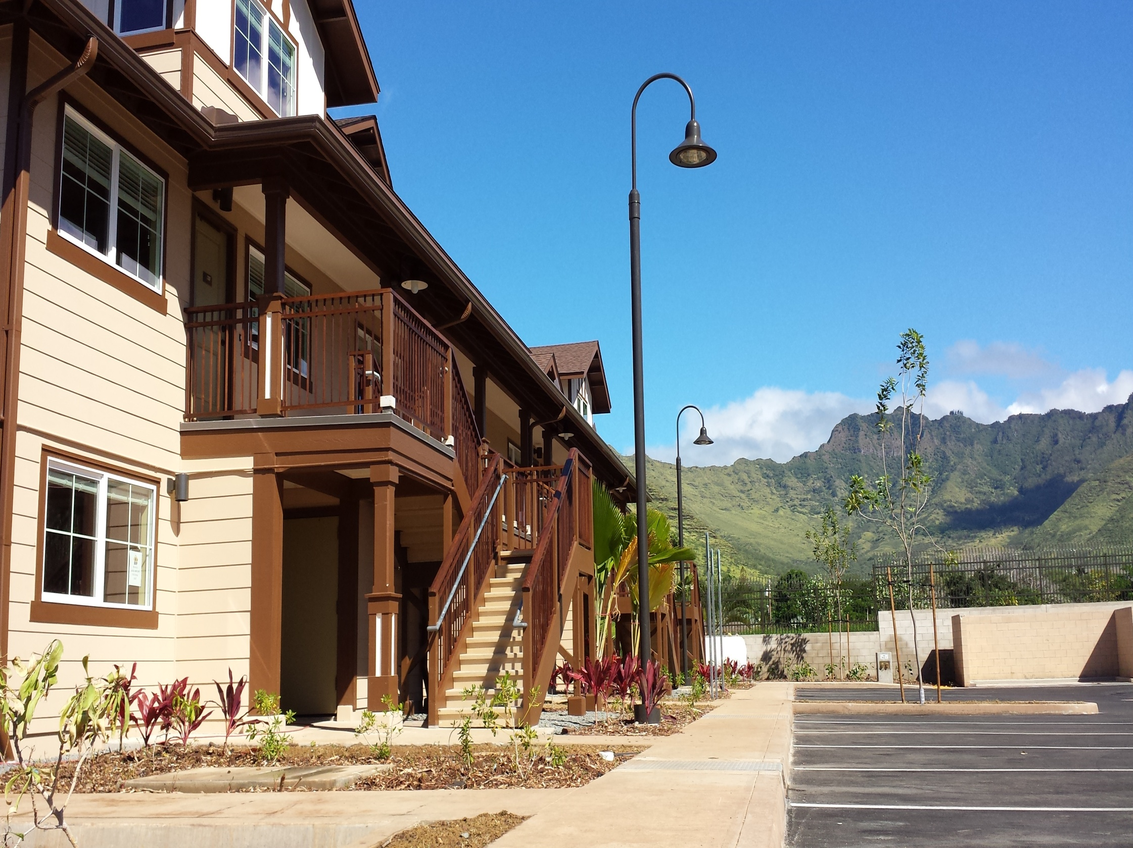
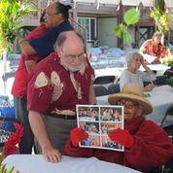
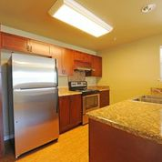
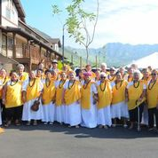
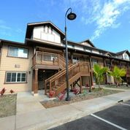
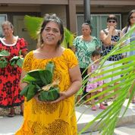
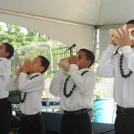
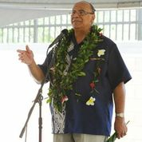
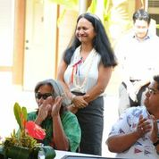
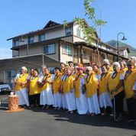
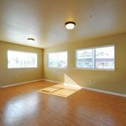
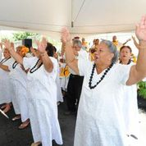
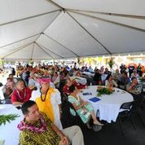
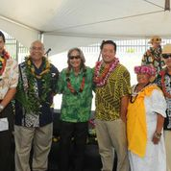
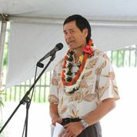
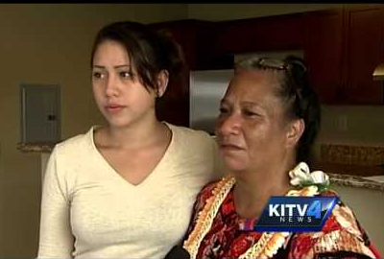
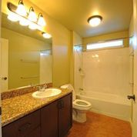
Hale Makana Dedication Feb 2014
Affordable Housing
And
Services
DHHL Land
State, Federal & County Funding
Low-Income Tax Credits & Bonds

Slide 14


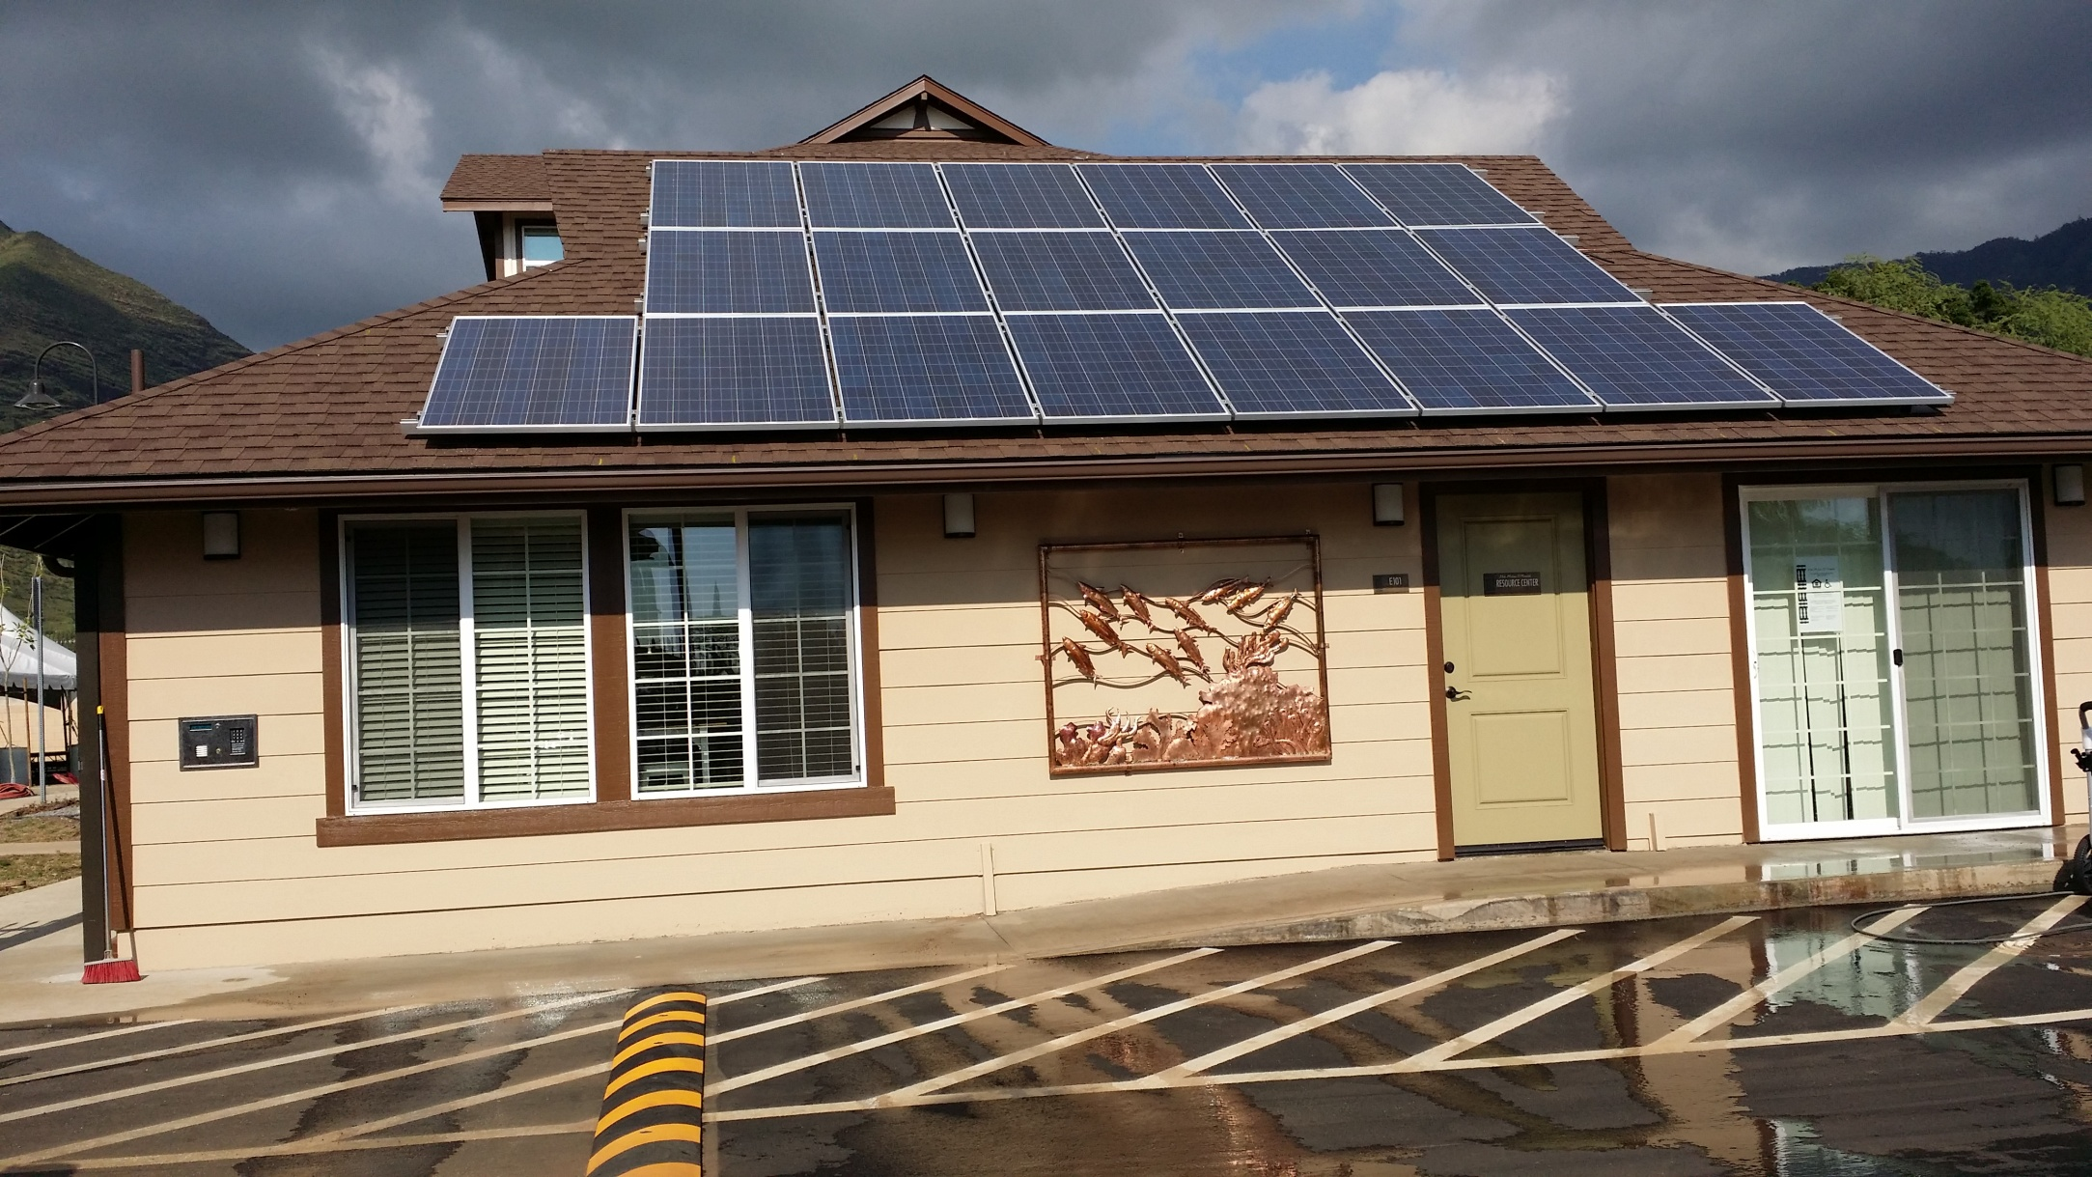
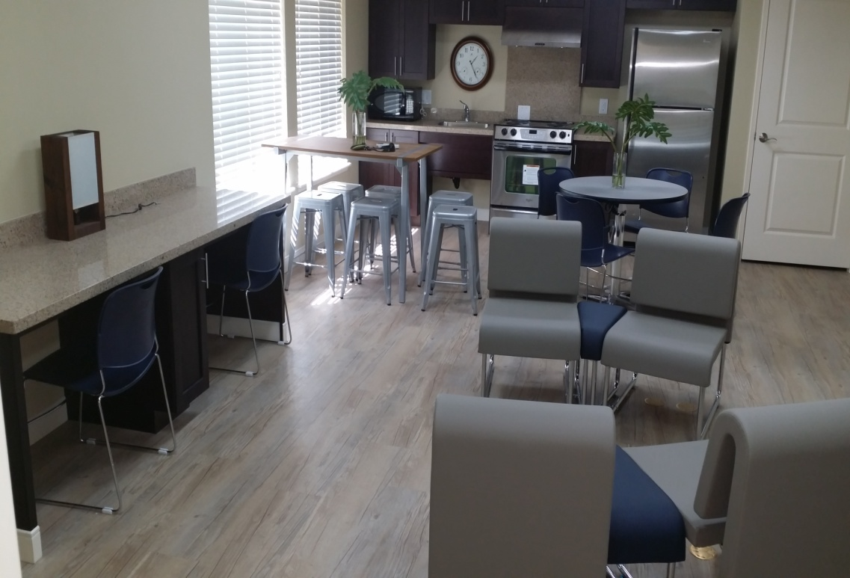
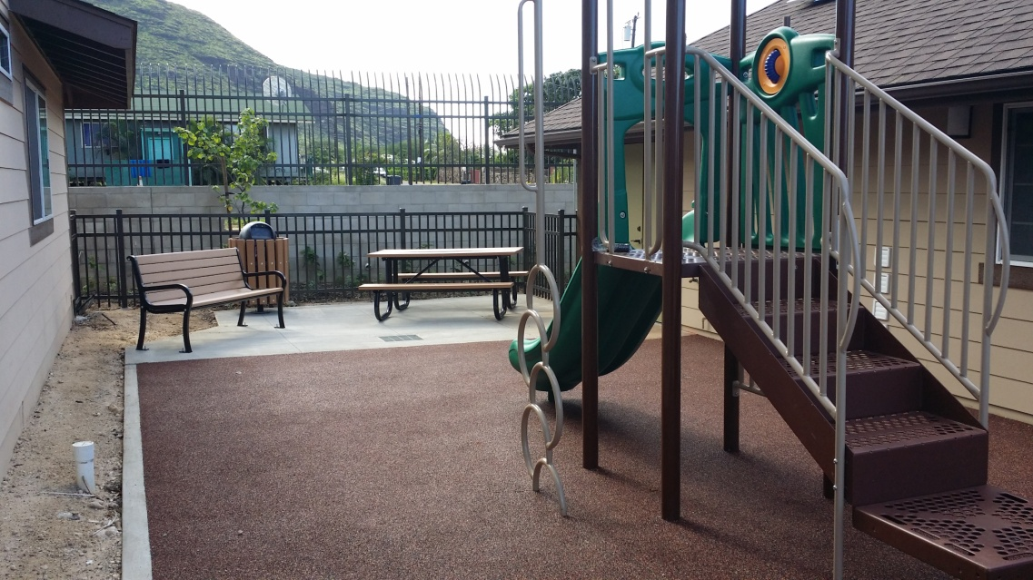
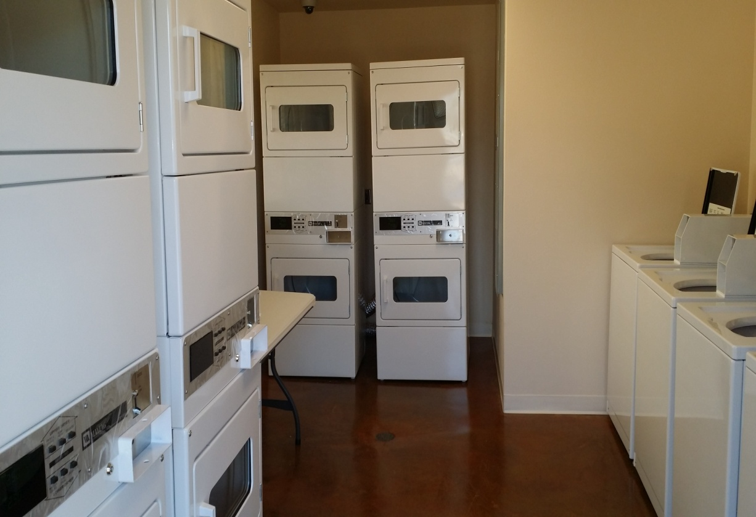
Hale Makana Resource Center
Notes:
UHWO, HUD – Resource Center/Laundry

Slide 15
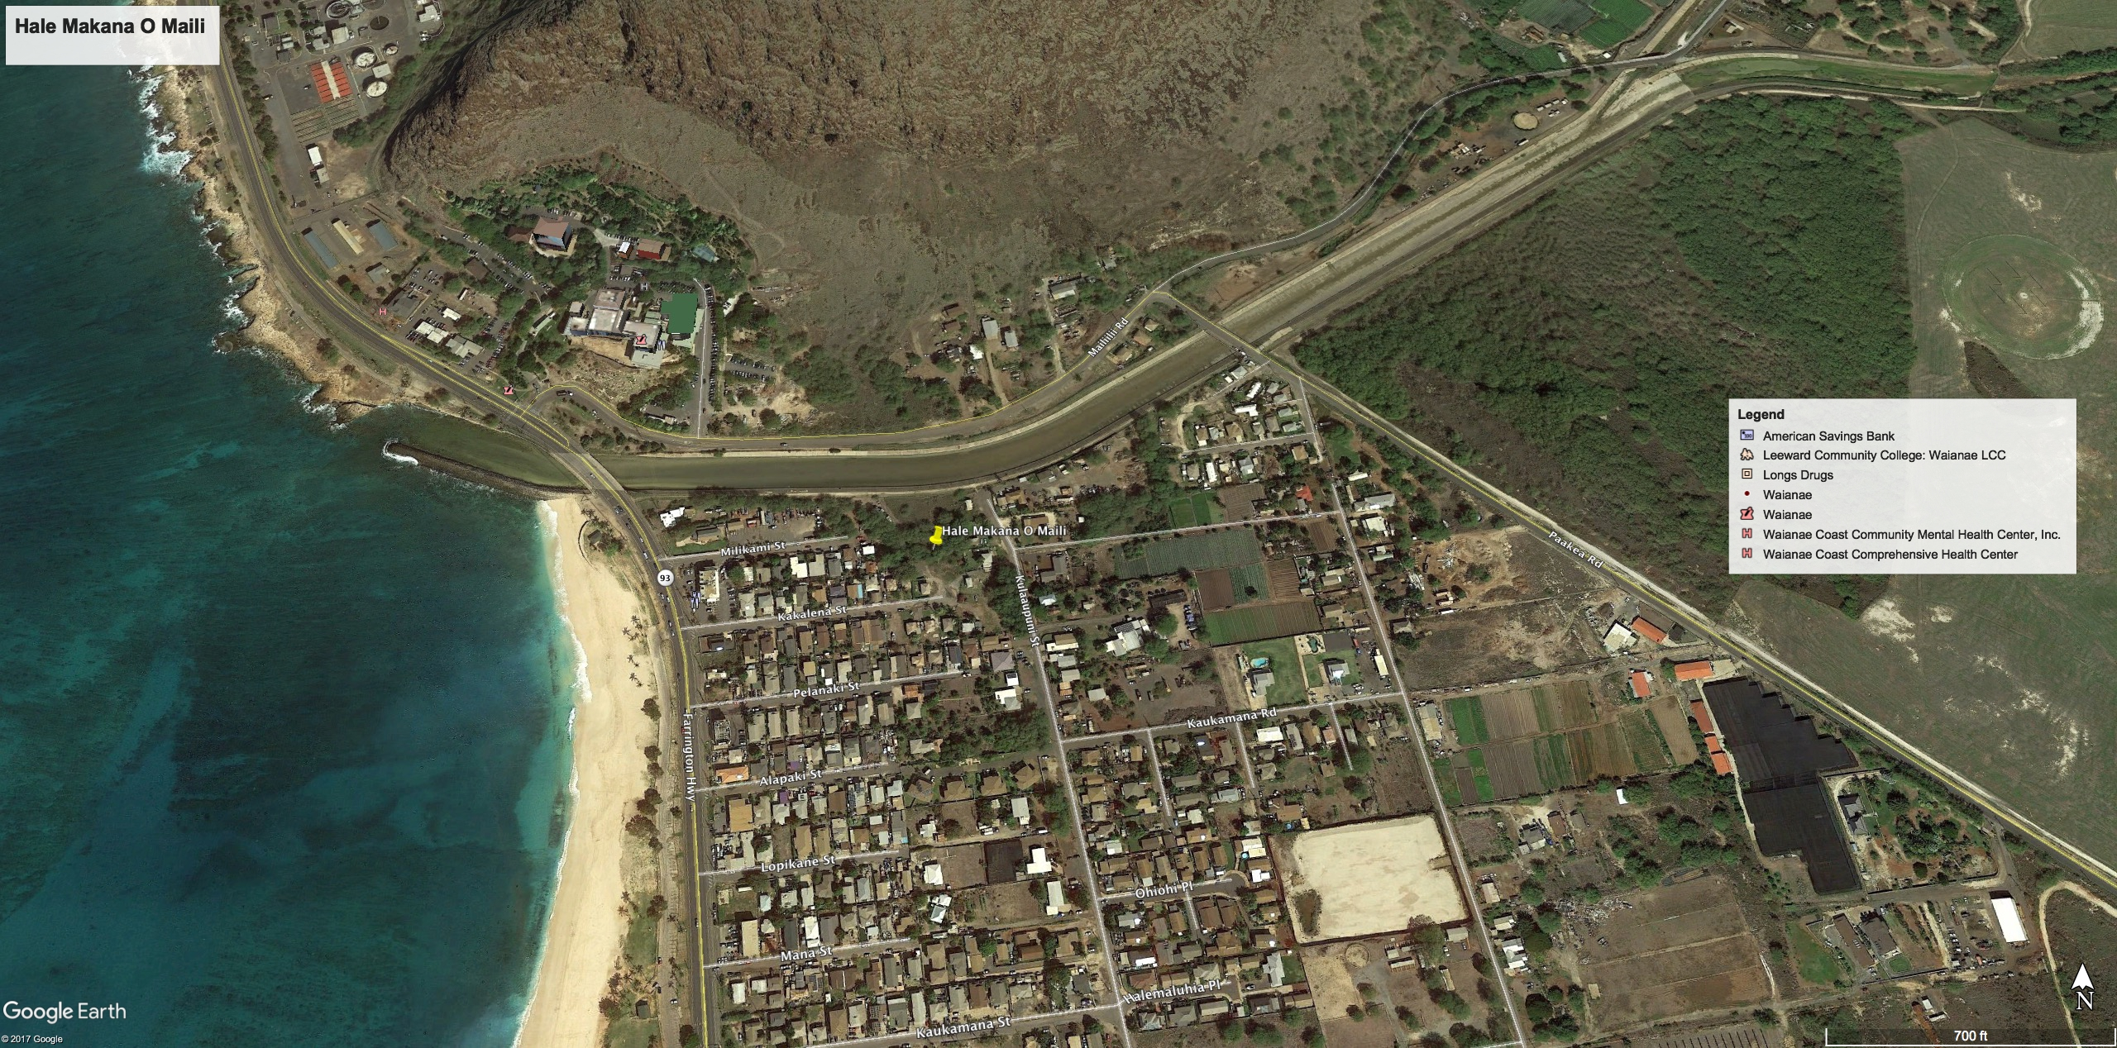
Hale Makana O Maili
Project
Waianae Comp
Project Site
Notes:
Future LIHTC Project on private lands

Slide 16
Hale Makana O Maili
Notes:
Maili Project – 52 units – 1 to 3 bedrooms – 2 stories - Resource Center w/ a central park/garden area. Close to the beach, public transportation, WCCHC
$20 mil Project Budget: $2 mil County, 4% or 9% LIHTC

Slide 17
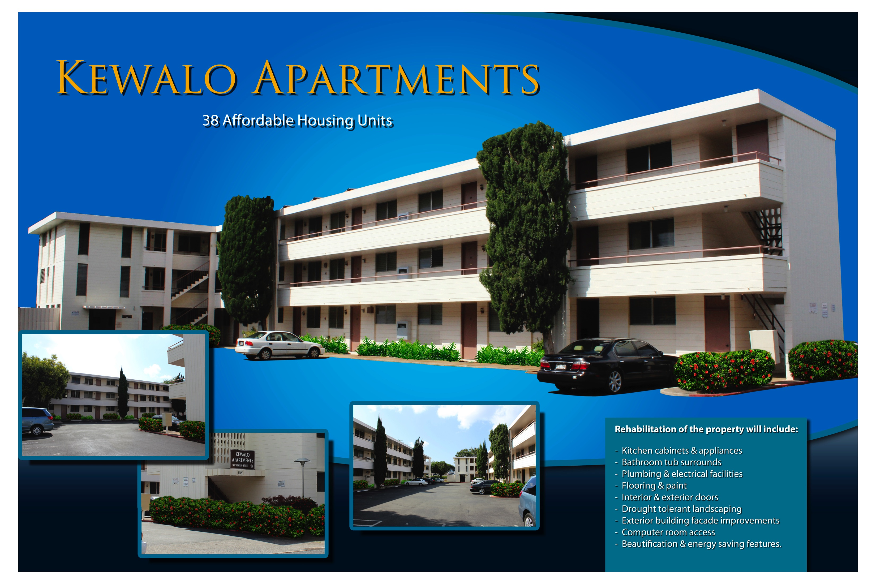
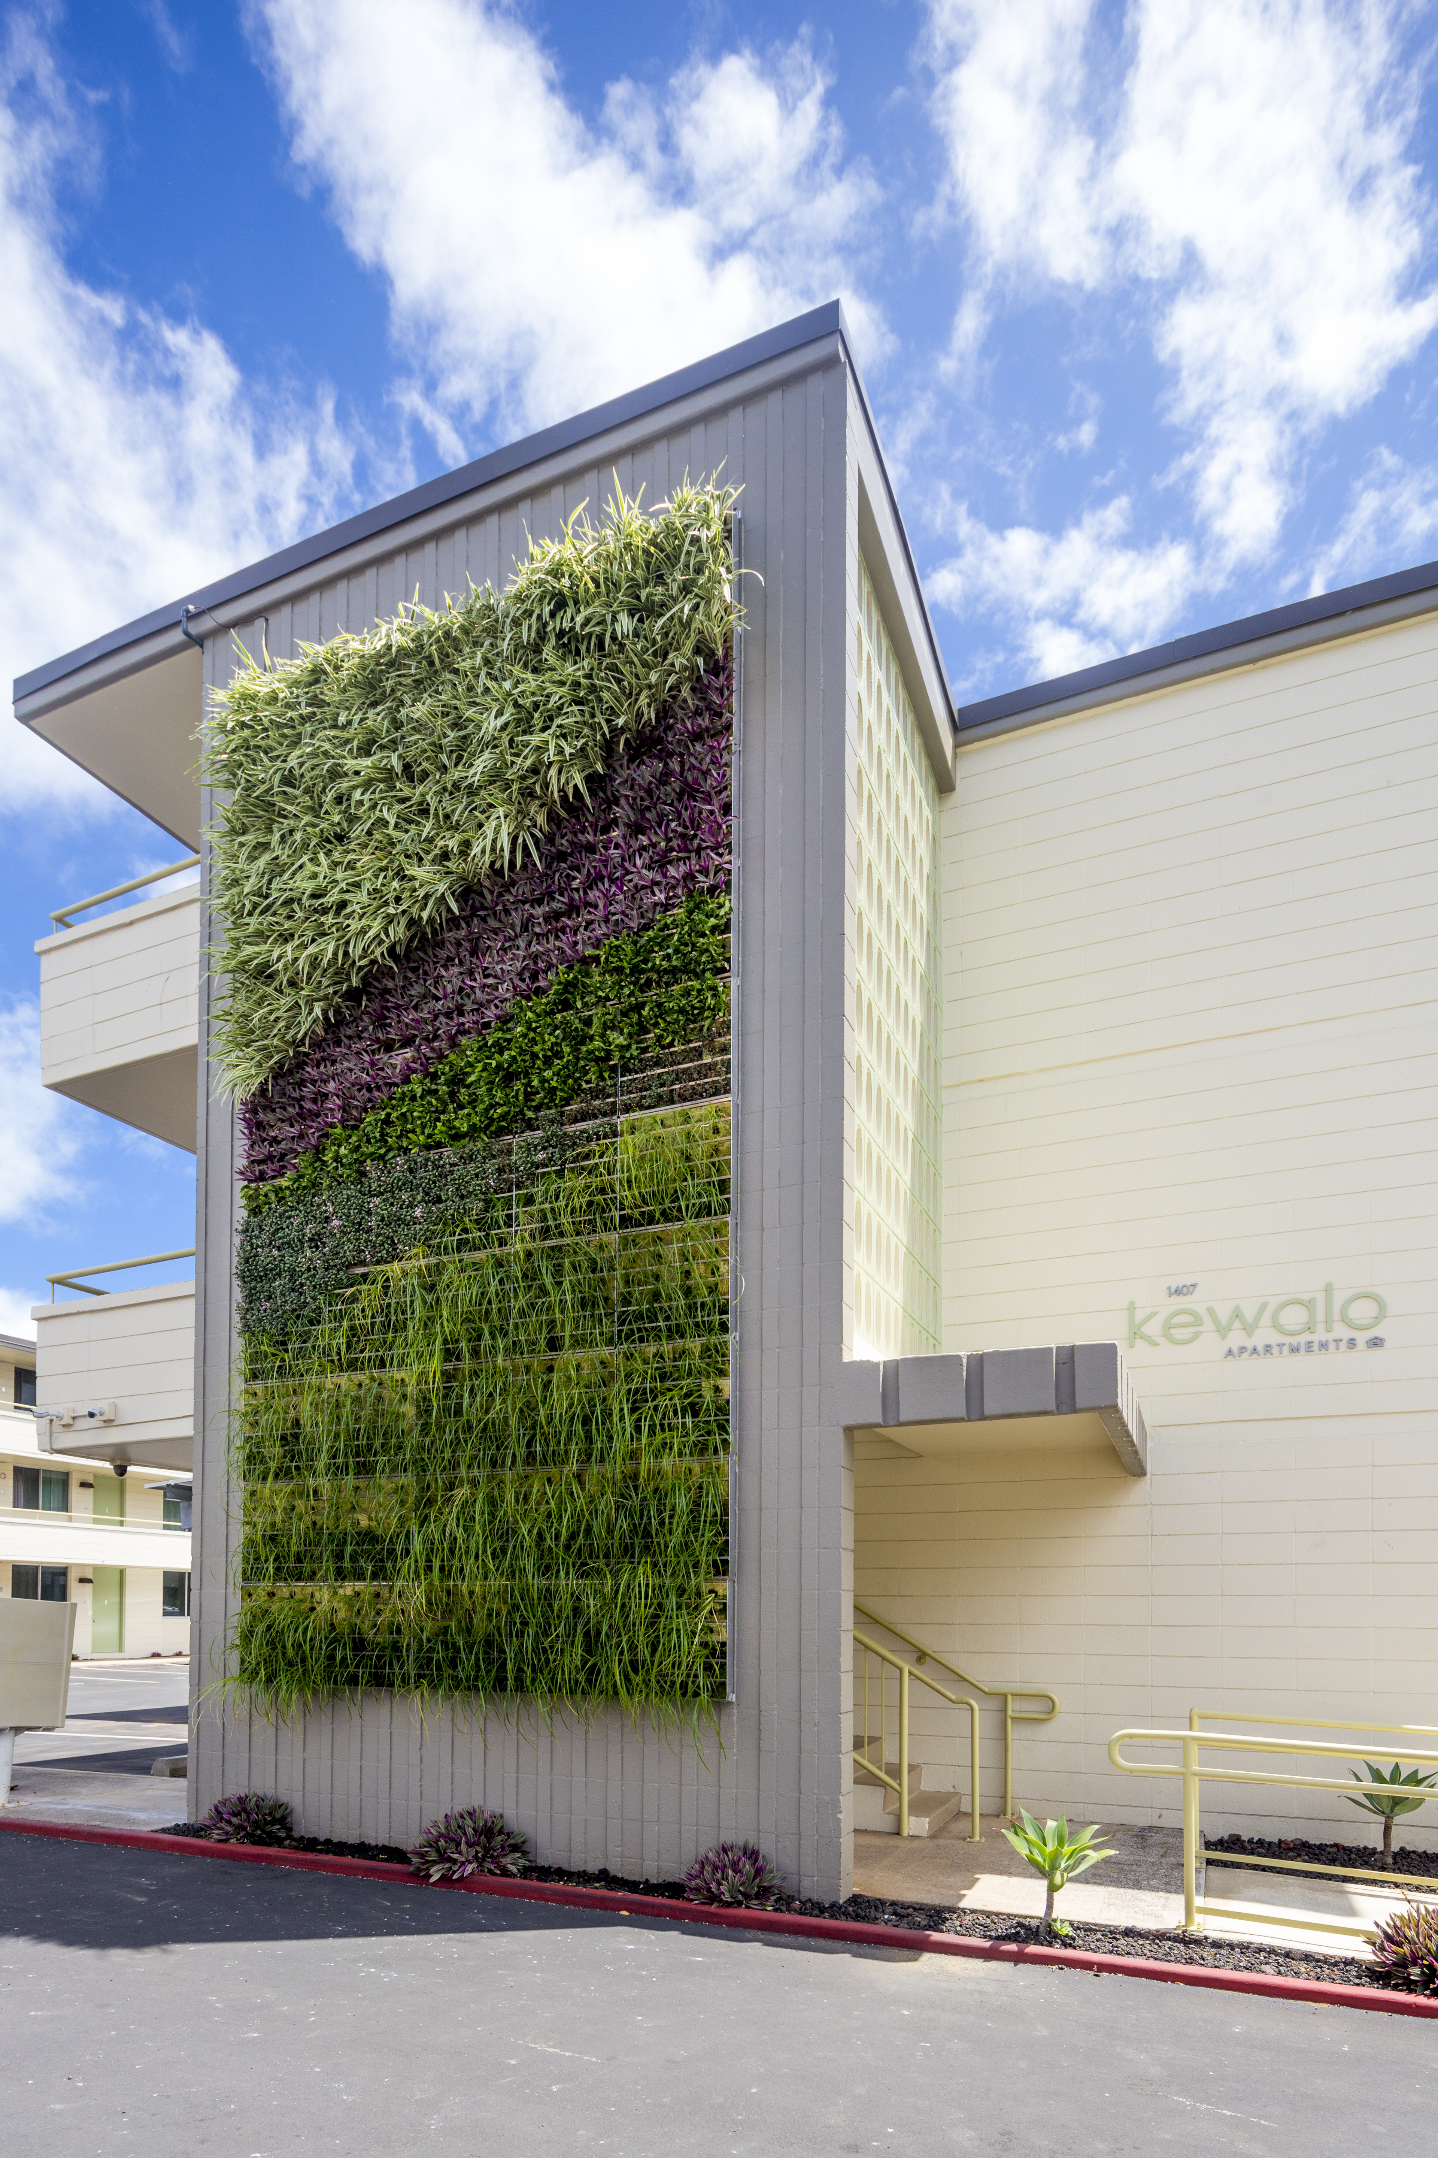
Notes:
38 unit affordable units – June 2015 - only 2 bedrm units– Rehab project – using 9% - in partnership with Pacific Dev Gp.
Built in early 1960’s under HUD 236 Loan Program, Currently has Sec 8 residents.
Project Costs: $11.8 mil:
9% LIHTC
$3 mil RHTF
$3.3 mil HUD loan

Slide 18
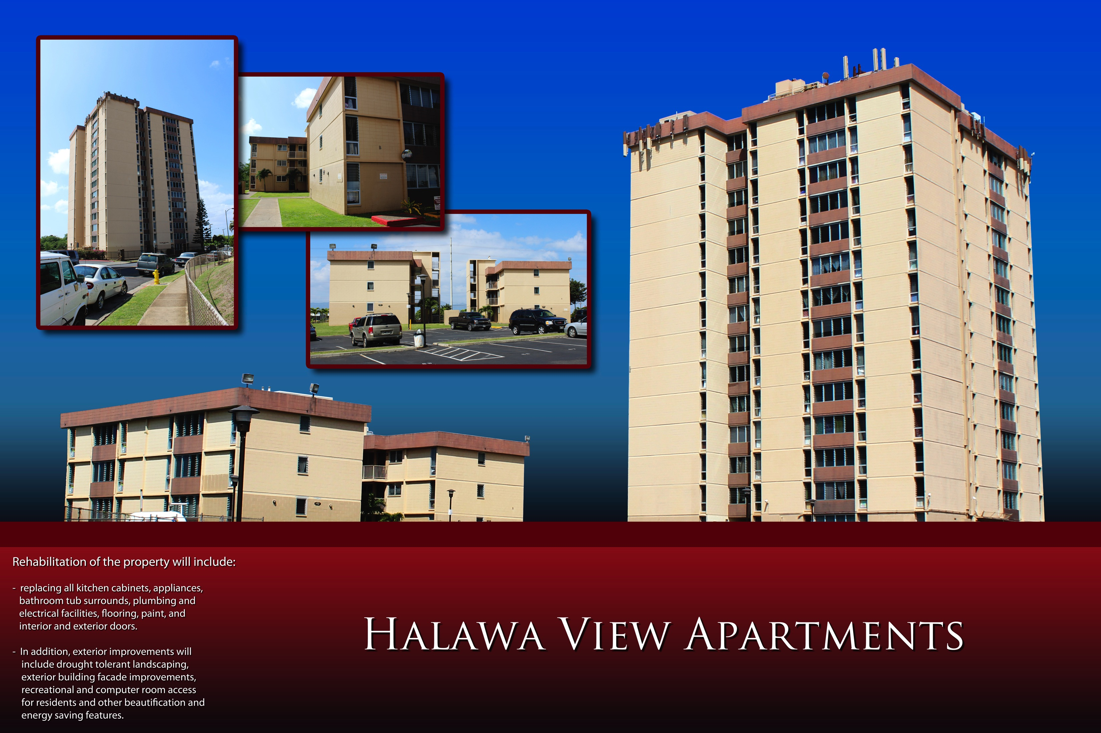
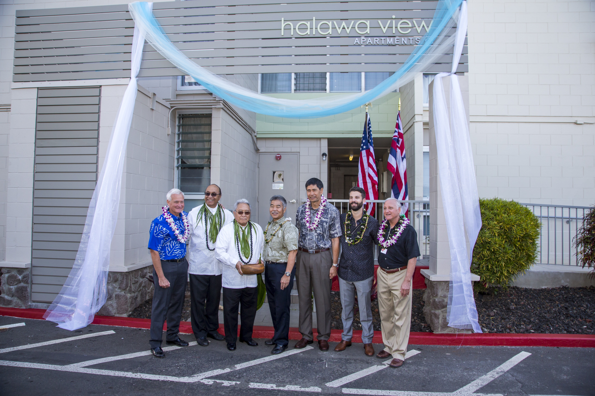
Notes:
LIHTC $18.7 mil Rehab Project: Feb 2016
121 units near Pearl Harbor – 14 story property built in early 1970’s under HUD 236 Loan Program. 24 project based Sec 8 residents. One high-rise and 2 mid-rise buildings, Contains 2, 3, & 4 bedroom.
Again partnered w/ Pac Dev group using LIHTC

Slide 19
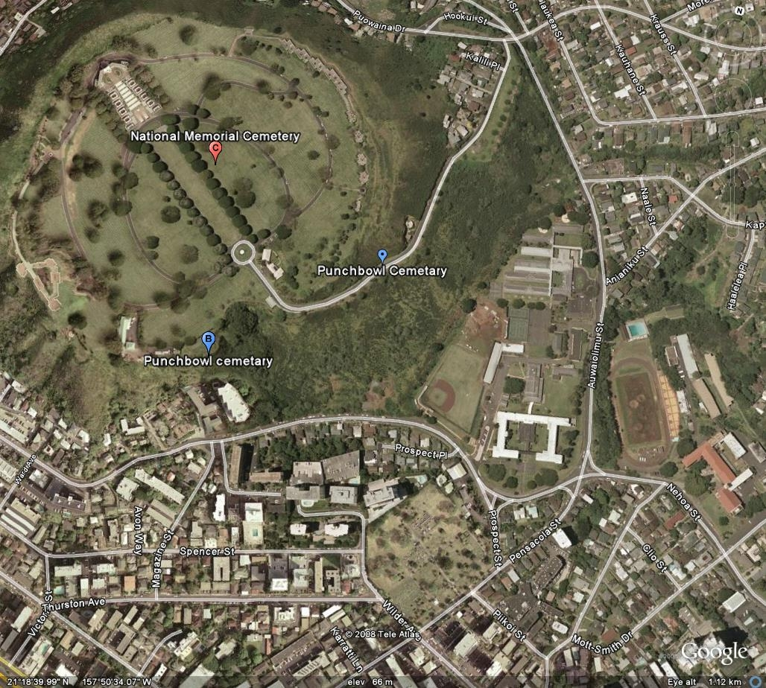
Punchbowl Project
Project Site
Notes:
DHHL Potential Project

Slide 20
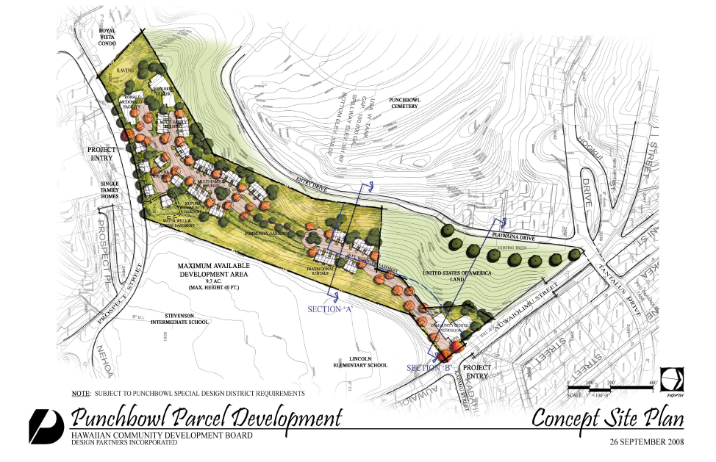

Notes:
15 acres – multifamily, kupuna housing, transitional rentals, resource center

Slide 21
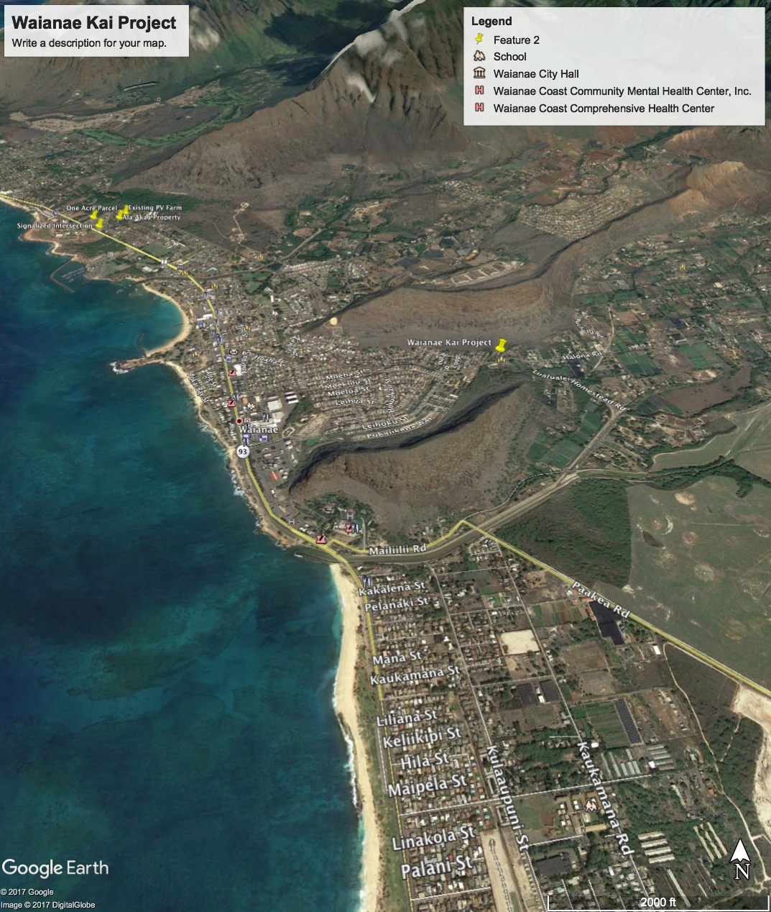
Project Site
Project Site
Notes:
Another potential project on DHHL lands being proposed by a homestead association.

Slide 22
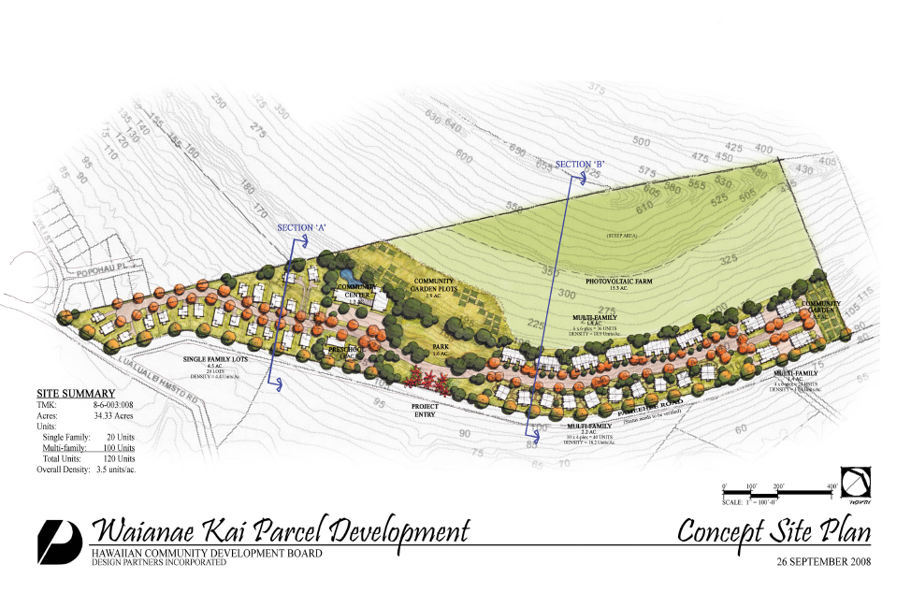
Notes:
34 acre DHHL lands – Waianae Kai Association – proposed project: 120 units: Single family, multi family, housing for special needs, community center and gardens, PV Farm

Slide 23
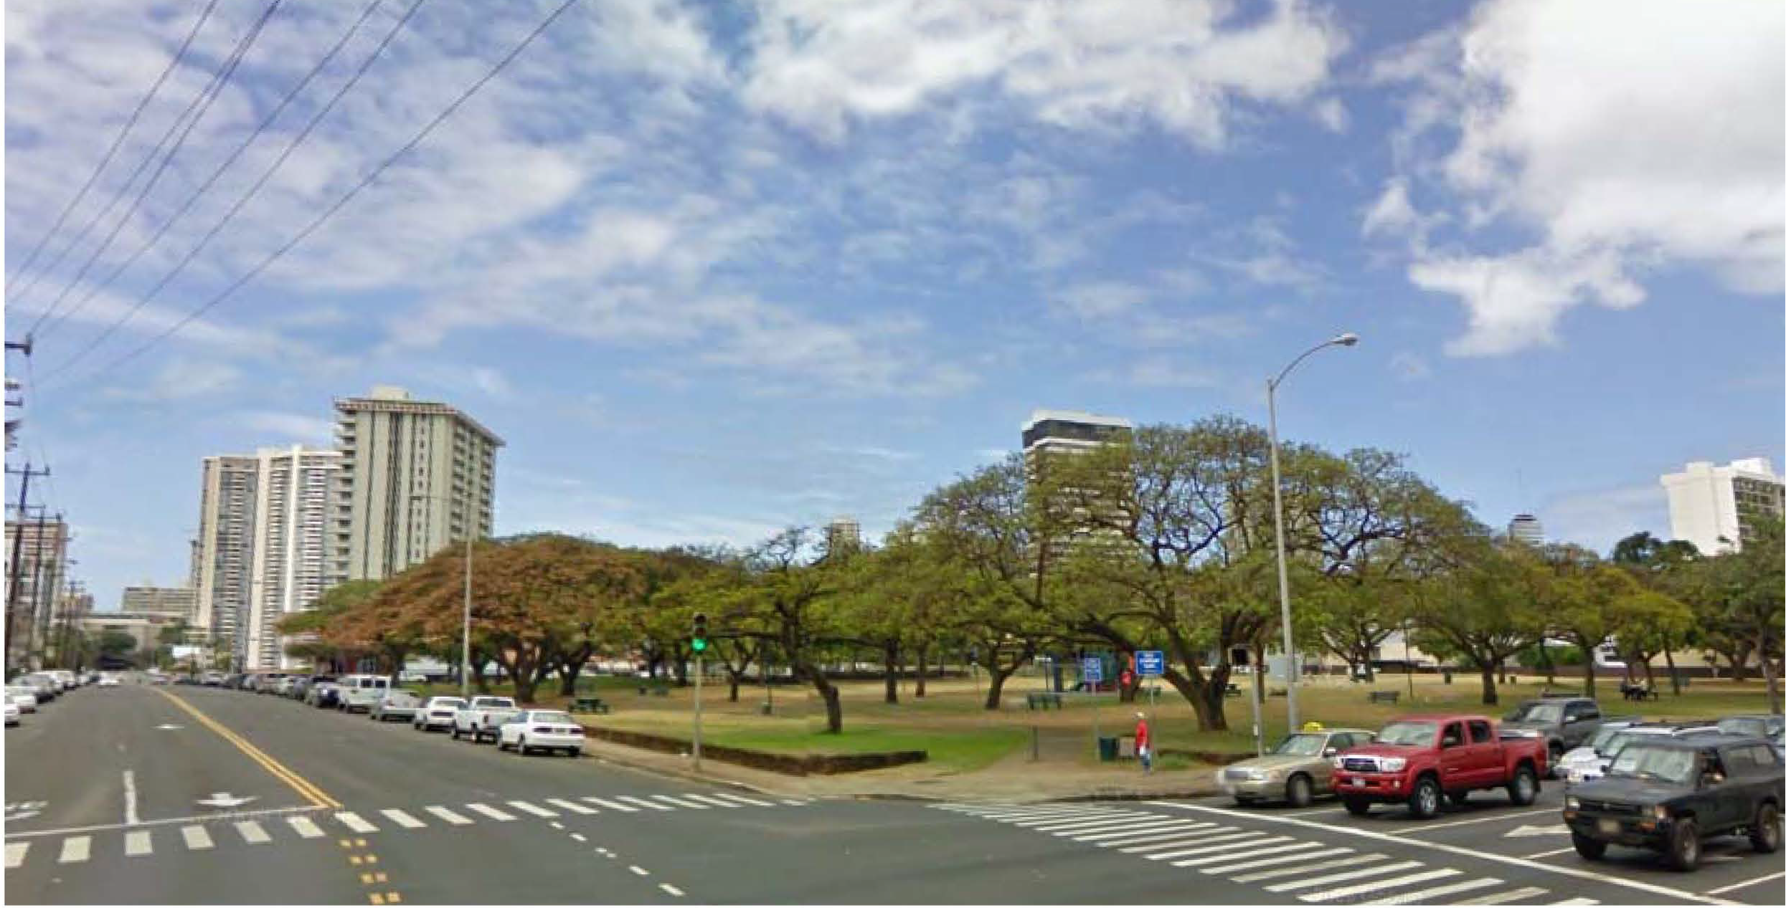
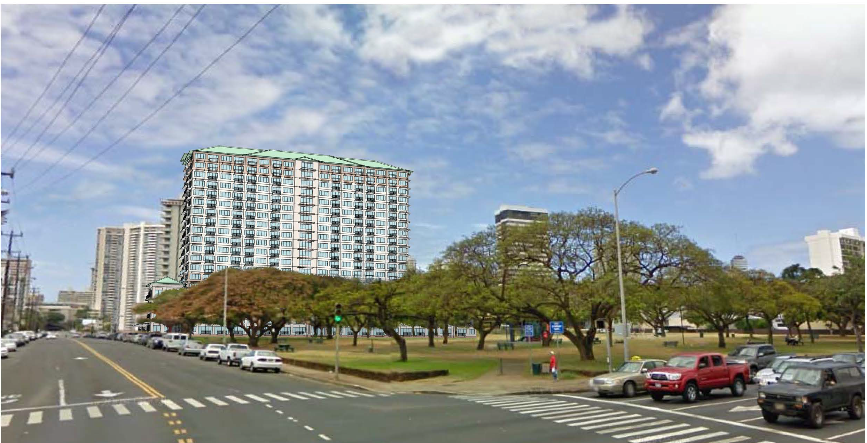
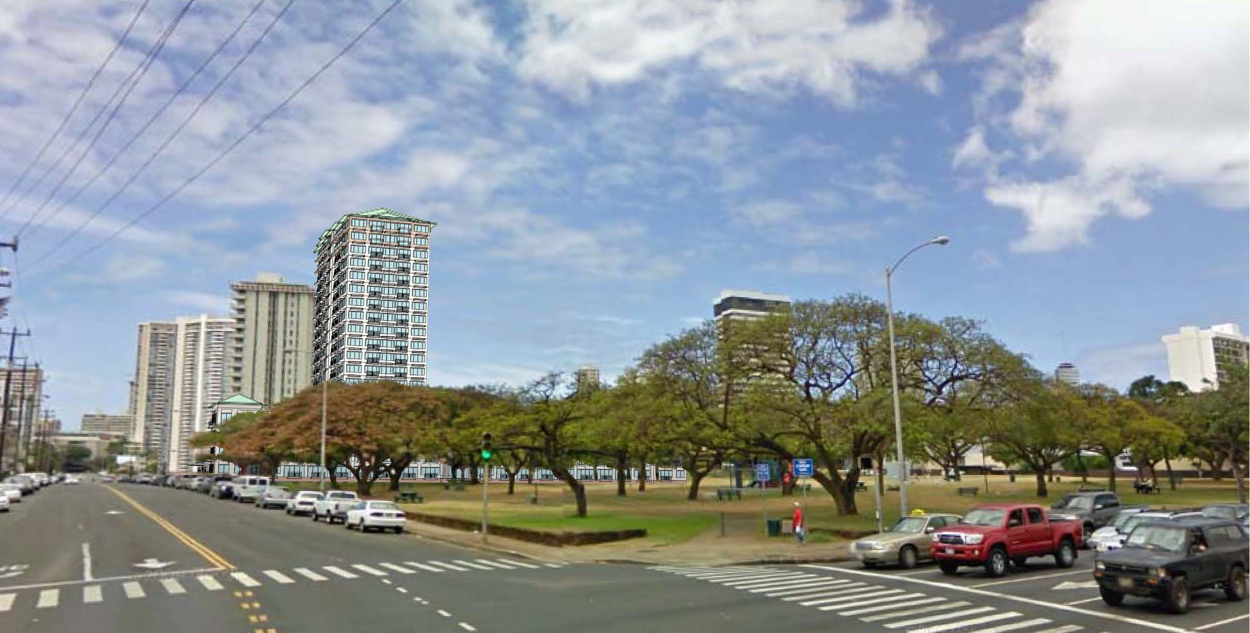
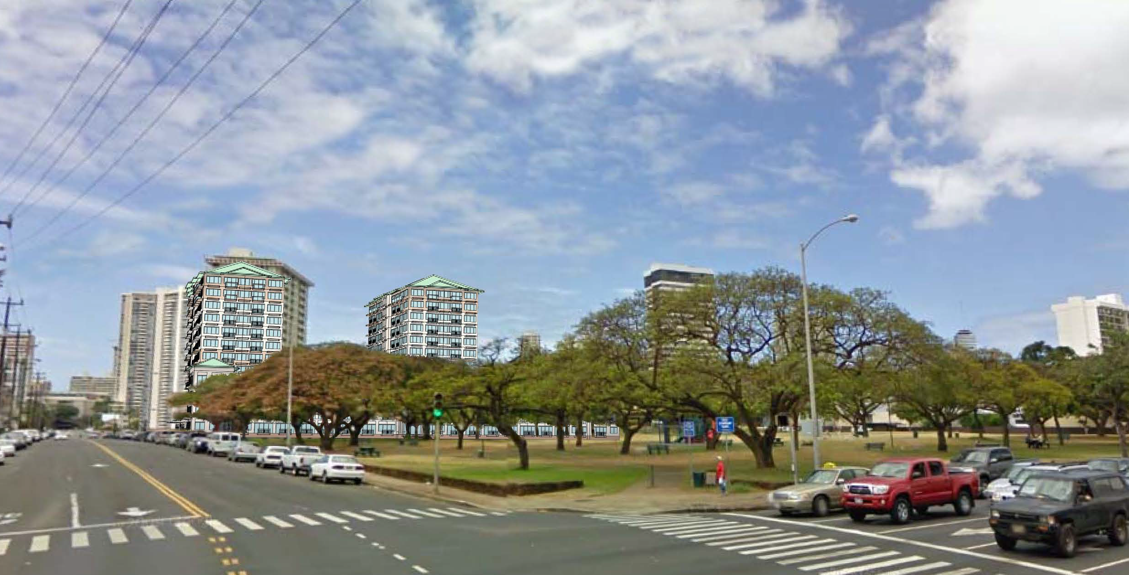
Hawaiian Home lands - Bowl a Drome
Notes:
Group 70
69/97 units Phase 1 (1 bdrm)
136 units
TOTAL: 369 Phase 1 & 2 (1 bdrm)

Slide 24
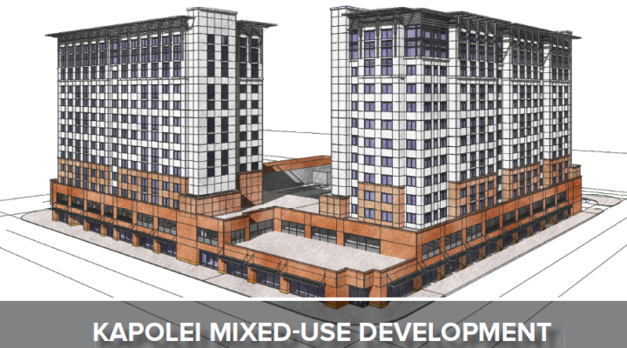
Notes:
Three phase Project. 3 acre block
1st Phase:13-story tower – 154 affordable senior rental units above commercial space –
13 story - 143 units (studio to 3 bdrm) – 30% - 60%AMI
Project Sponsors include: Coastal Rim Properties, Inc.; Highridge Costa Development Company LLC; and Hawaiian Community Development Board;
Sept 2017 HHFDC approved the $64 mil project funding:
$28 mil LIHTC
$16.5 mil HMMF Bond
$18 mil RHRF
3rd phase – additional single story retail

Slide 25
Second Units as an
Affordable Housing Solution
Hawaiian Community Assets
Hawaii Appleseed
Hawaiian Community Development Board

Slide 26
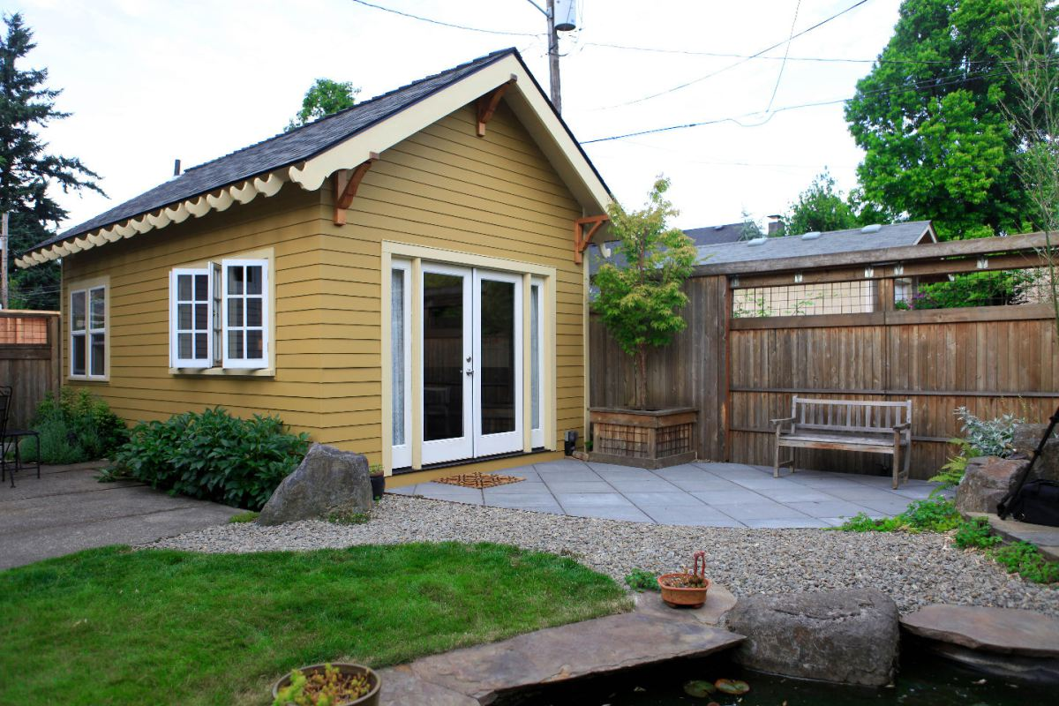
What is and ADU?
An Accessory Dwelling Unit (ADU) is defined as a second dwelling unit, including its own kitchen, bedroom, and bathroom facilities. It may be attached or detached from the primary dwelling unit on the zoning lot. ADUs are intended to be “accessory” to the primary dwelling, and are typically much smaller in size.
Also known as backyard cottages or mother-in-law units
Similar to ohana unit, but with different size restrictions and rentable to family or non-family tenants.

Slide 27
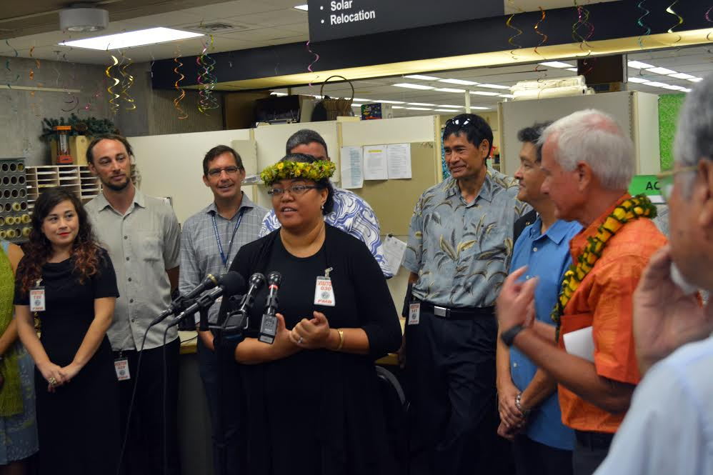
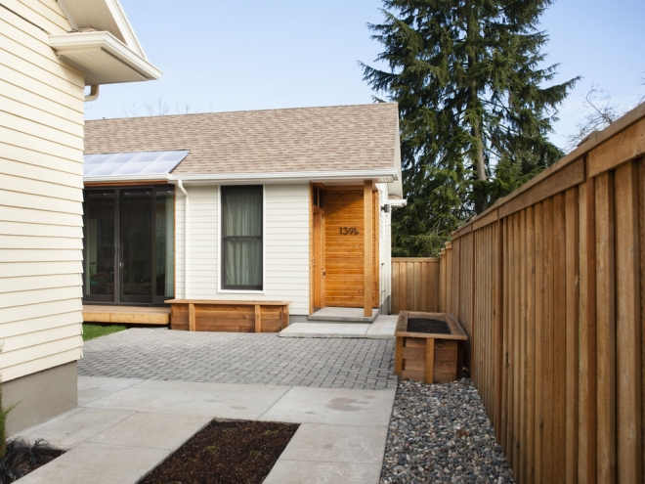
ADU Ordinance signed into law
News clip video
Requirements for an ADU:
Lot size of 3,500-4,999 sq ft → ADU of up to 400 sq ft
Lot size of 5,000 sq ft or more → ADU of up to 800 sq ft
Must provide one parking stall for ADU, unless lot is within ½ mile of light rail station
Must have adequate water, sewer, and road infrastructure
Must have signed rental agreement for periods of at least 6 months

Slide 28
ADU Rules on Hawaiian Home Lands
DHHL Administrative Rule
§10-3-34 Building requirements.
No building structure or improvement may be constructed on the premises without written approval from the commission. Such an approval shall be considered only after submission of a plan as to design, materials, and probable value and use of the structure to be built on the leasehold. Building structures or improvements shall meet building and zoning codes and other ordinances and regulations of the respective counties except as otherwise provided by the commission.
DHHL HHCA Rental Section
§208. Conditions of leases.
“Provided that a lessee may be permitted, with the approval of the department, to rent to a native Hawaiian or Hawaiians, lodging either within the lessee's existing home or in a separate residential dwelling unit constructed on the premises.”
Notes:
City & county of Hono passed a ADU/Ohana ordinance that allows separate/partitioned and extension to existing houses. Therefore allows Homesteaders to expand and provide more housing for family and native Hawaiians.

Slide 29
Waianae
  915 Residential Homesteads

Slide 30
Nanakuli
1,049 Residential Homesteads

Slide 31
Papakolea, Kewalo,
& Kalawahine
407 Residential Homesteads

Slide 32
Waimanalo
755 Residential Homesteads

Slide 33
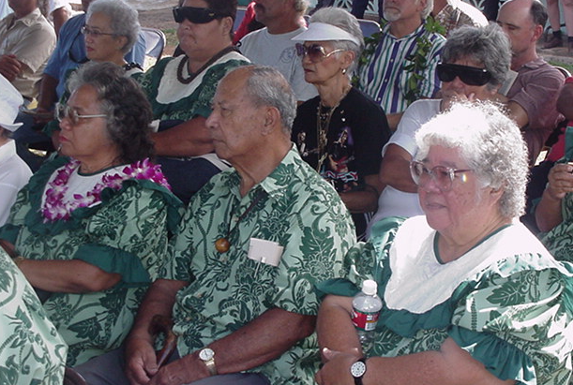
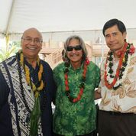

United in Order to Progress
“Pupukahi I Holomua”
Mahalo and A hui Hou

